Slide 1

Want to change the director?
Not happy with the lead actress?
Want to create your own dream cast?
Want a movie version of Fantasy Football?

Slide 2

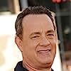
Fantasy 3 Movies
Ryan Callebs
John Bass
Yong Zhang

Slide 3


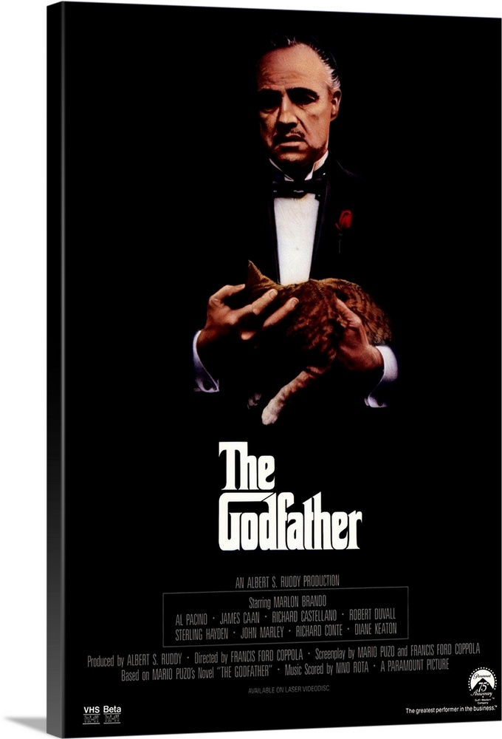


Introduction
Fantasy 3 Movies
Welcome to Fantasy 3 Movies! We're your premier destination for film aficionados and industry insiders alike. At Fantasy 3 Movies, we specialize in crafting imaginative and captivating cinematic experiences. Join us on this fantastical journey where creativity reigns supreme and every movie is a thrilling adventure!

Slide 4
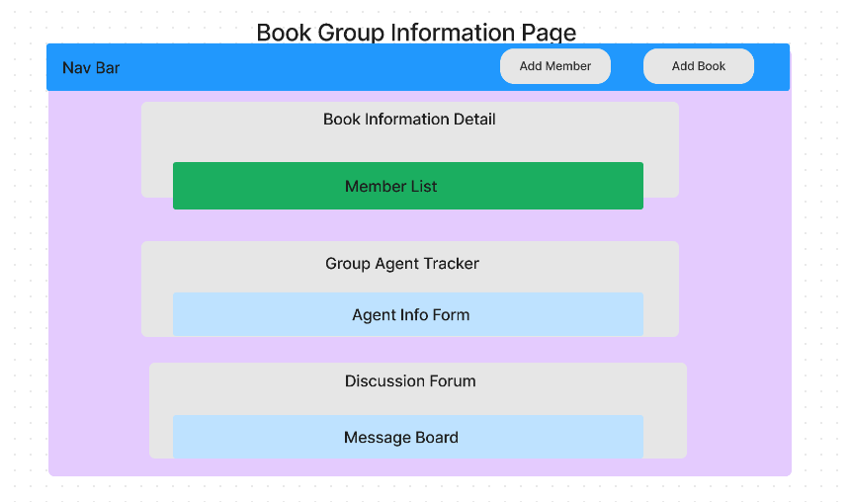

Slide 5
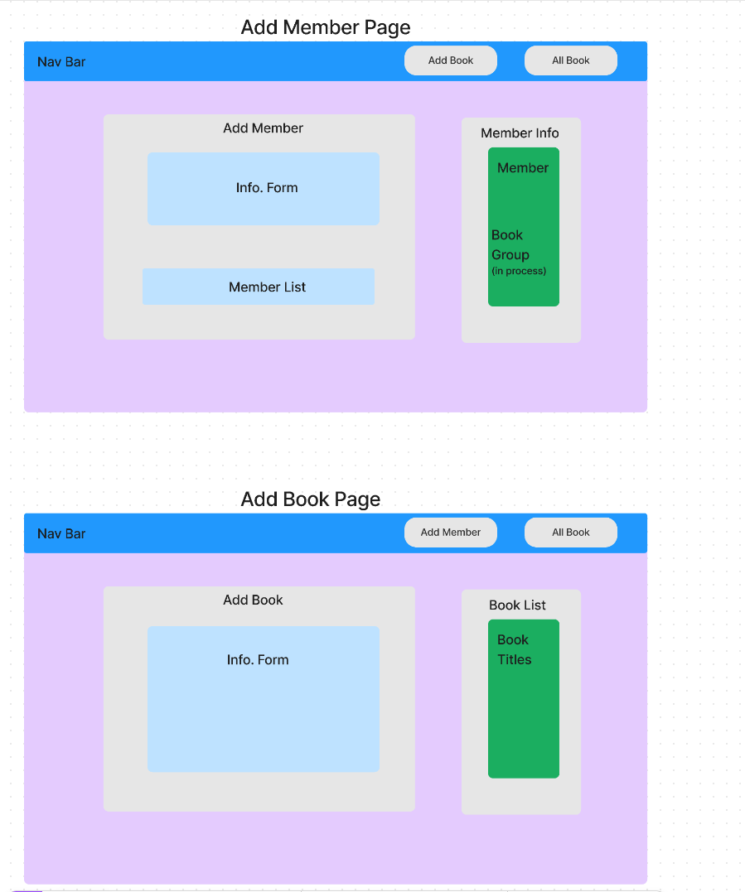

Slide 6
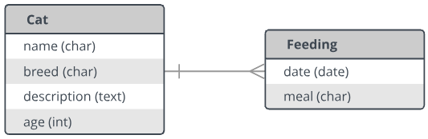

Slide 7
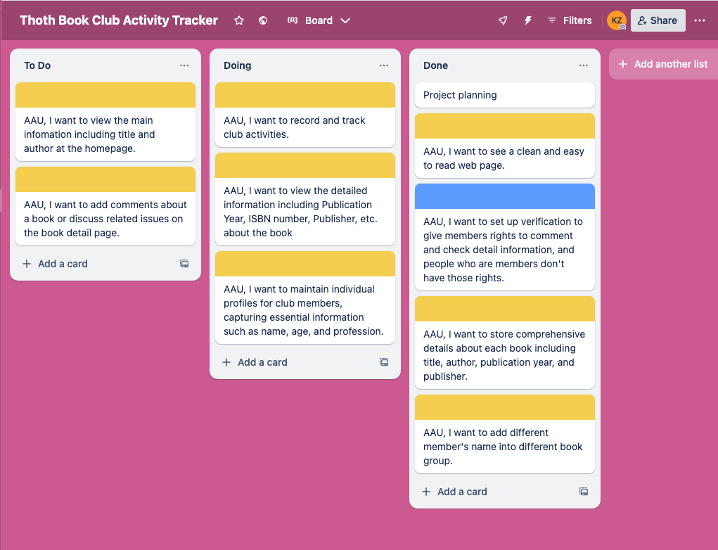

Slide 8









Slide 10



